Slide 1
Winter 2018 Midterm Report
Group 9: Brandon Dring, Carl Benson, Nipun Bathini

Slide 2
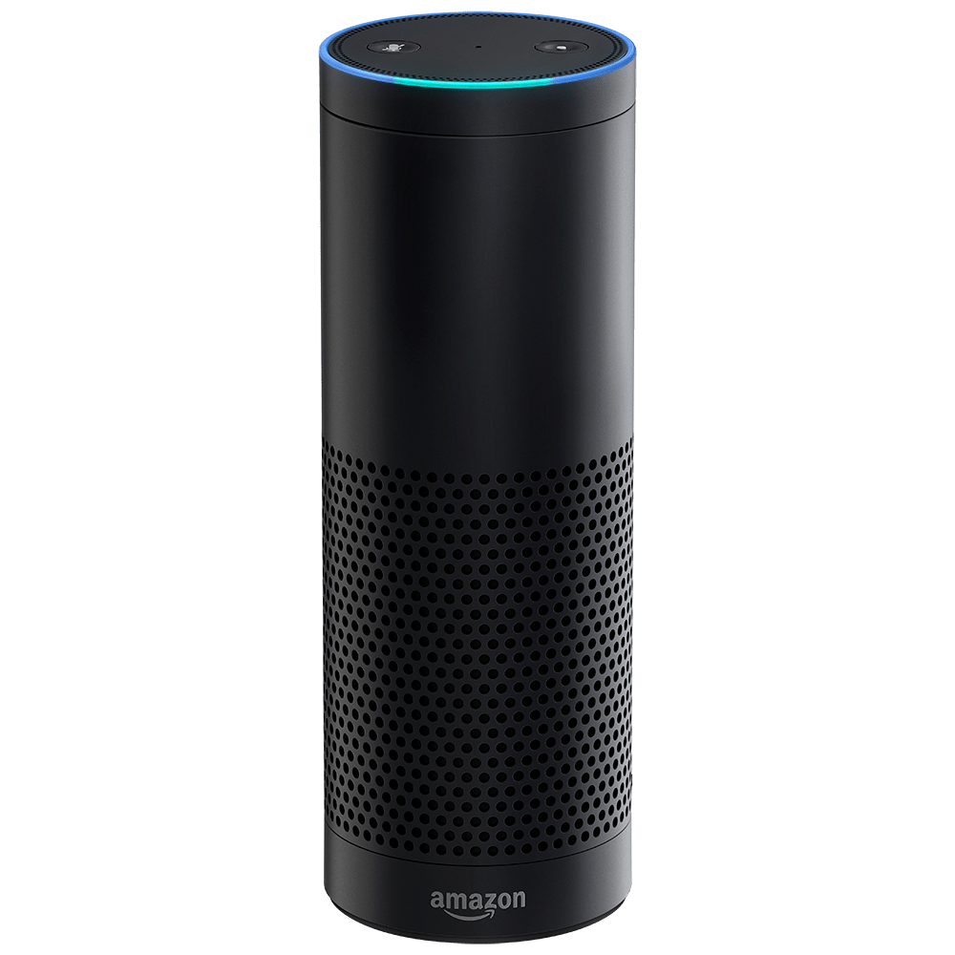
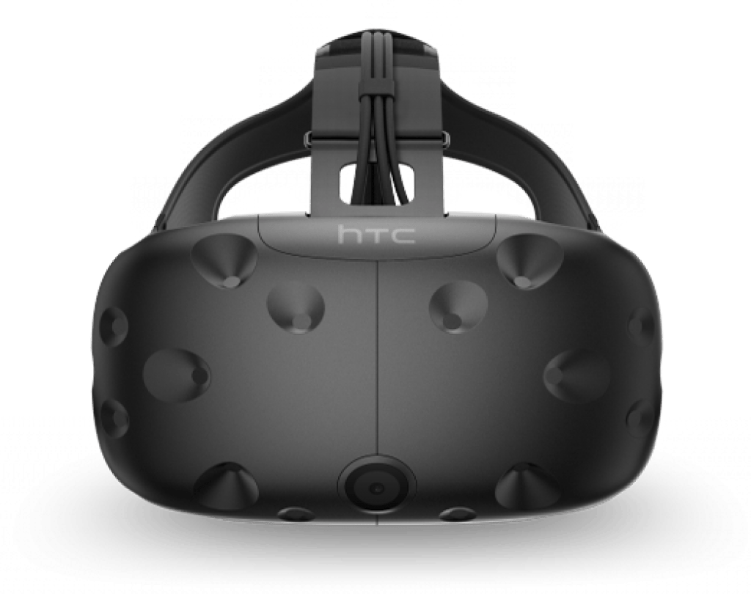

Alexa Progress
Returns MongoDB data from Request
Improved Responses
Added Socket.IO rooms
Tests
Data Model
Photo: Amazon
Photo: HTC
Photo: MongoDB

Slide 3
Alexa Left to do
Pull last user state from DB and append to current request
Reset filters for when Alexa refines queries further
Alexa offering suggestions
More tests using AWS tab
Alexa Keyword for maps

Slide 4
Alexa: Problems
Created our own Data
Added more than one dealership in a City
Multiple users can now use the project

Slide 5
AWS Progress
Connection between Echo, DB, and Vive
Take queries from Echo
Validates queries
Pass along to DB and receive data back
Pass data along to Vive
DB filled with generated values

Slide 6
AWS Left to Do
Additional Routes
Logging Suggestions
SocketIO Rooms

Slide 7
AWS Problems
Lack of SocketIO rooms on Unity

Slide 8
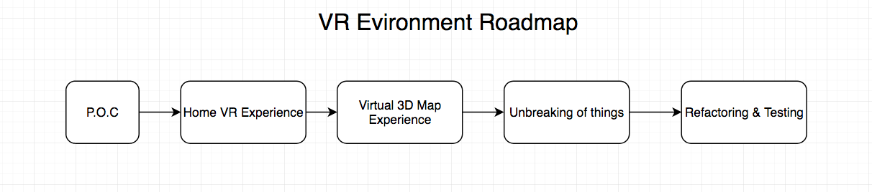
VR: Progress
Migrated away from proof of concept
Created Virtual house to pleasantly view various graphs.
Populate graphs in real time via Websockets to create 3D graphs
✅
✅

Slide 9
VR: Left to do
Next step is to create virtual 3D mapping environment.
Swap back and forth between environments
Unbreak all the code that magically gets broken
Refactor code to be maintainable and Testable
✅
✅

Slide 10
VR: Problems
Learning C# and Unity at the same time can be a real pain..
Handling merge conflicts with Unity’s own version control is next to useless.
Parsing through variable length & field value JSON in C# is incredibly difficult
Lack of documentation for the main packages used.

Slide 11
DEMO!

